Slide 1
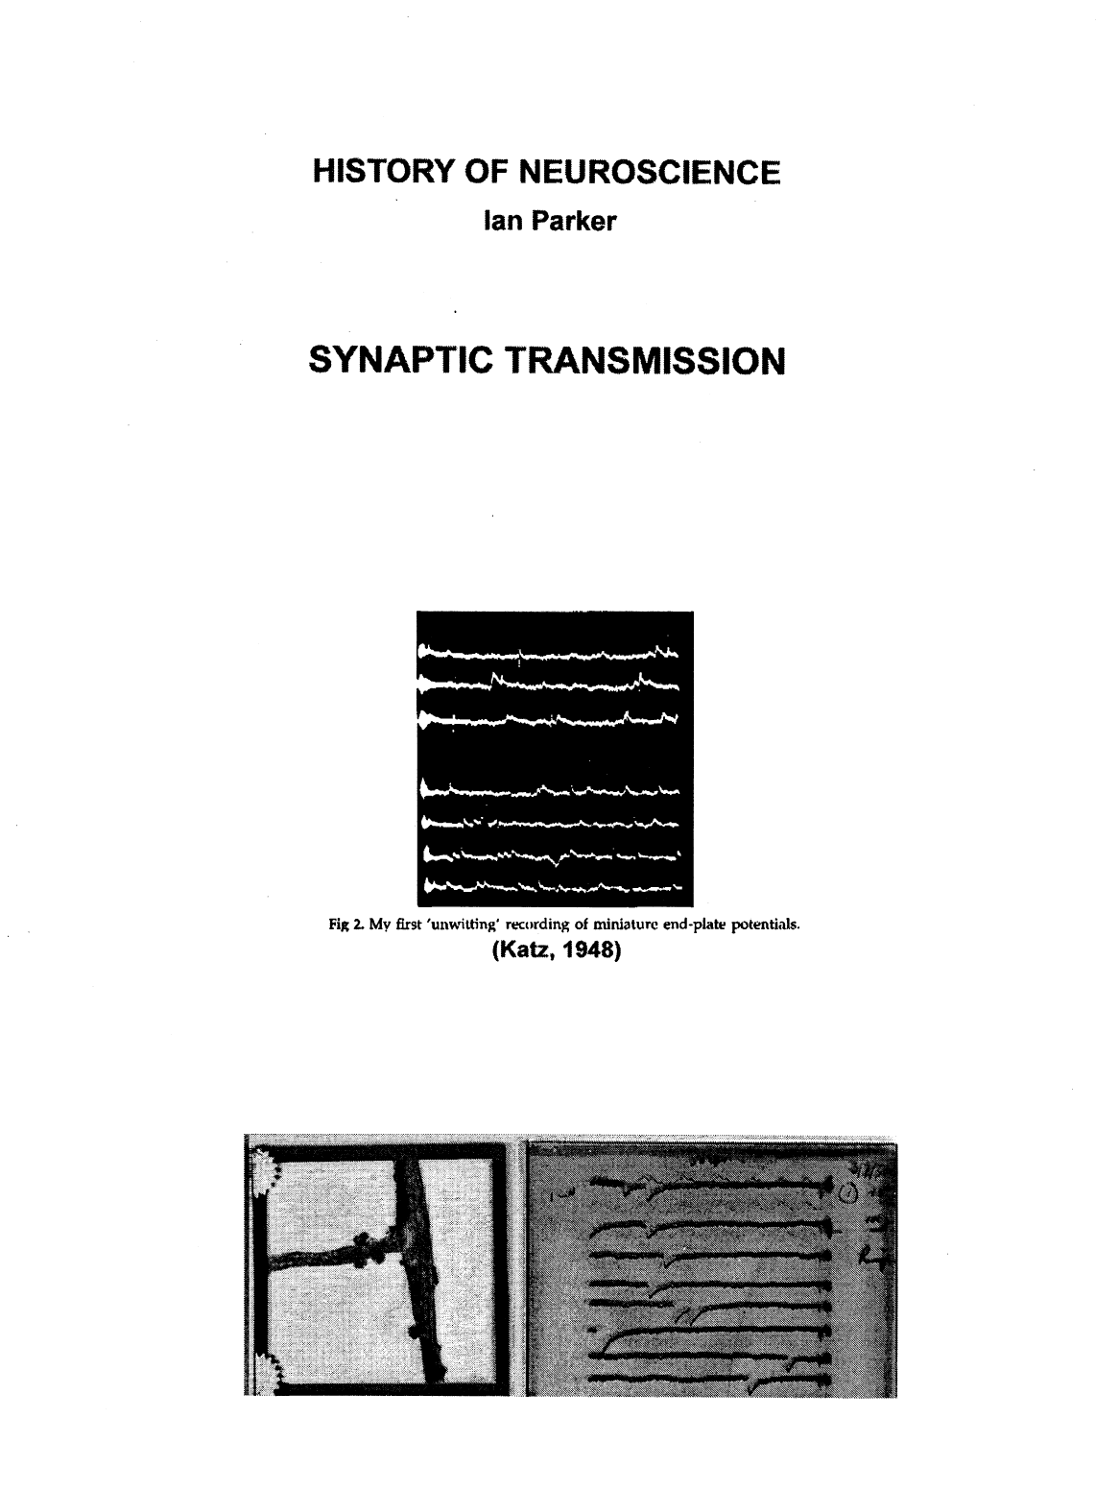

Slide 4
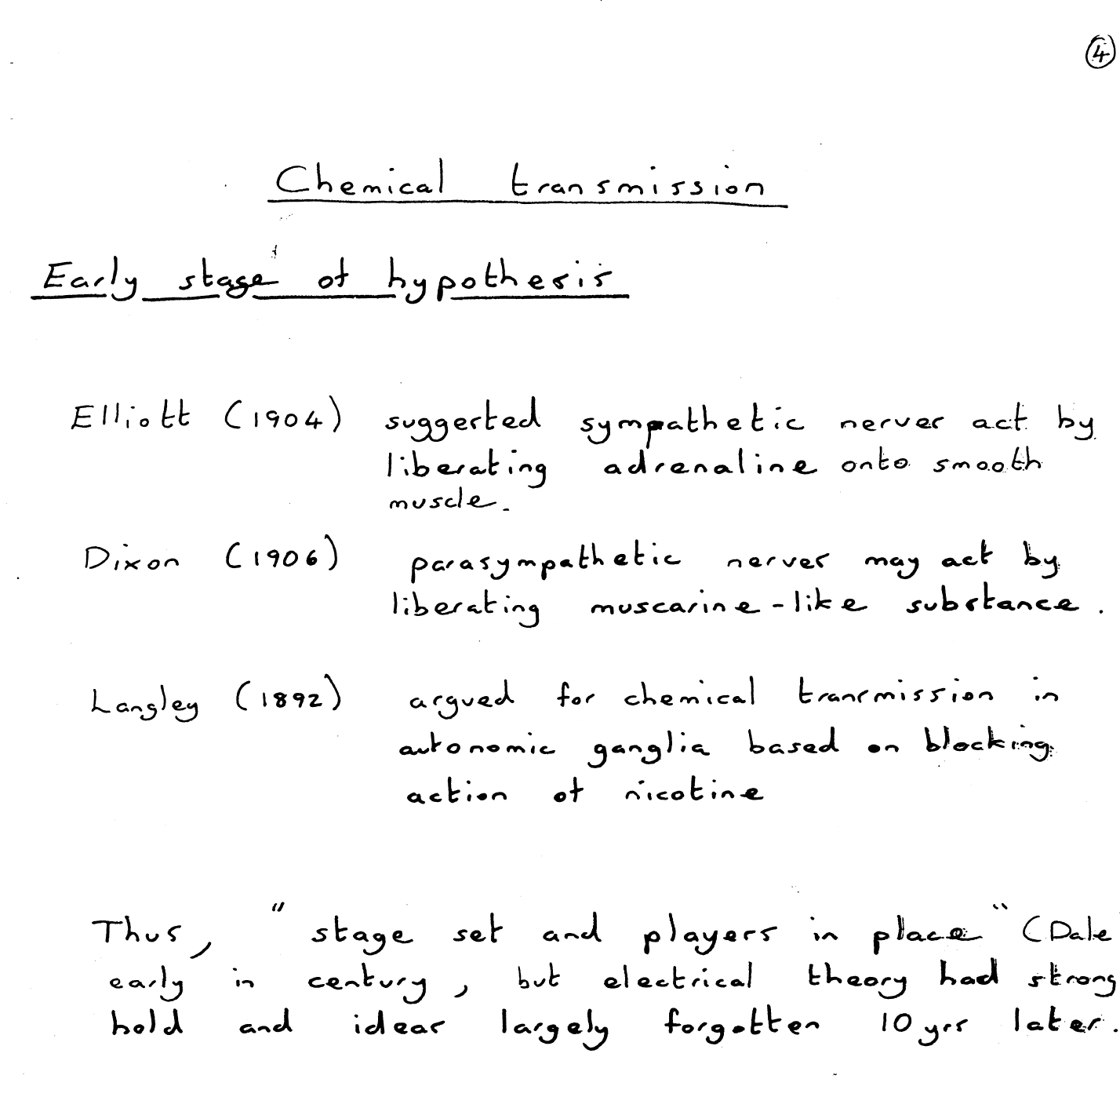

Slide 5
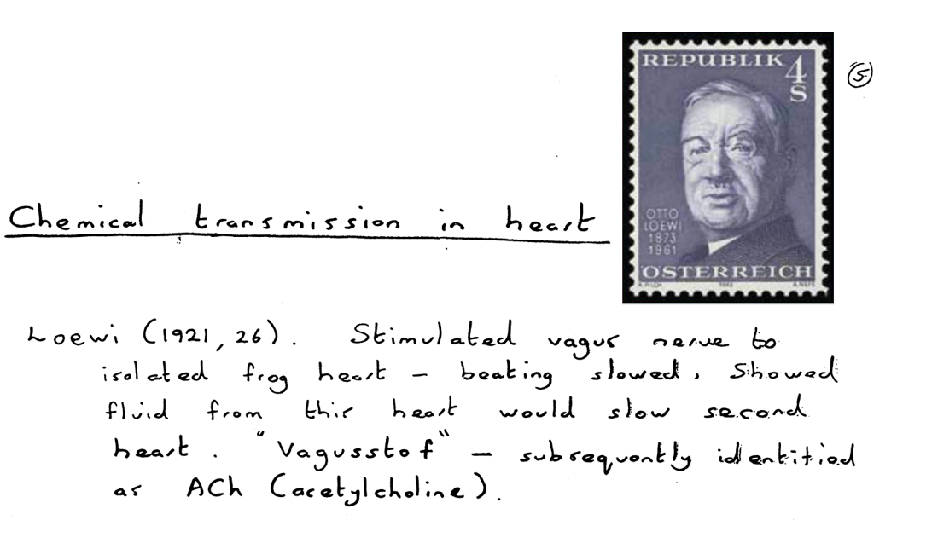
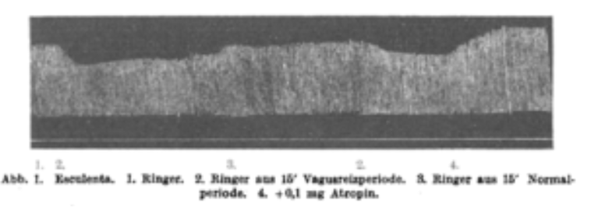

Slide 6
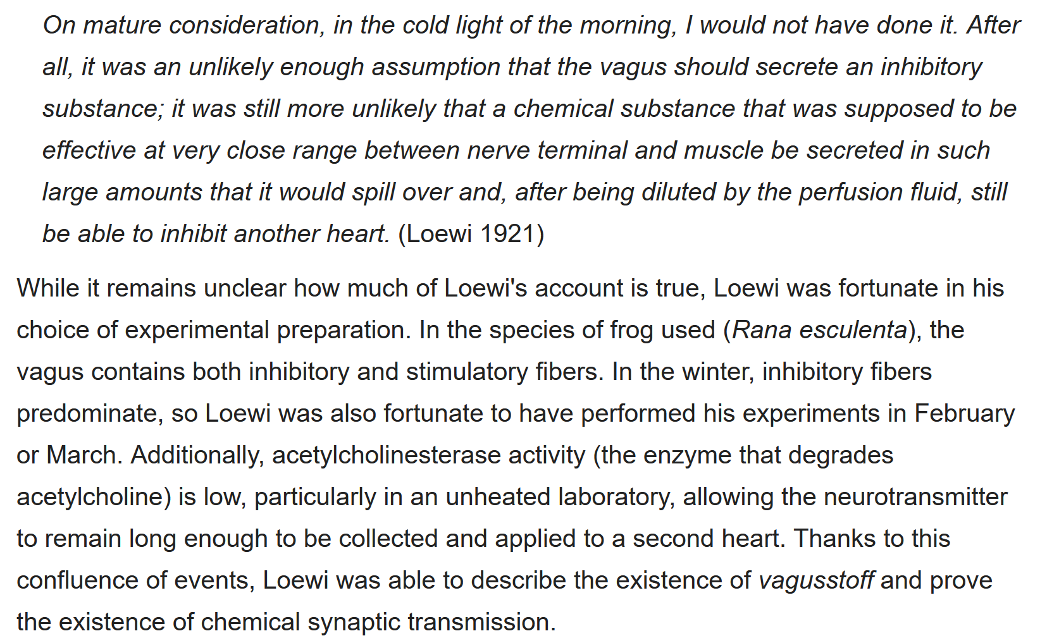
Otto Lowei’s dream…
Loewi apparently had the idea for his experiment in a dream. He wrote it down in the middle of the night but the next morning could not decipher his writing. He eventually had the same dream on another night, and decided to run to the laboratory to perform the experiment in the middle of the night. About this incident, Loewi writes:

Slide 8
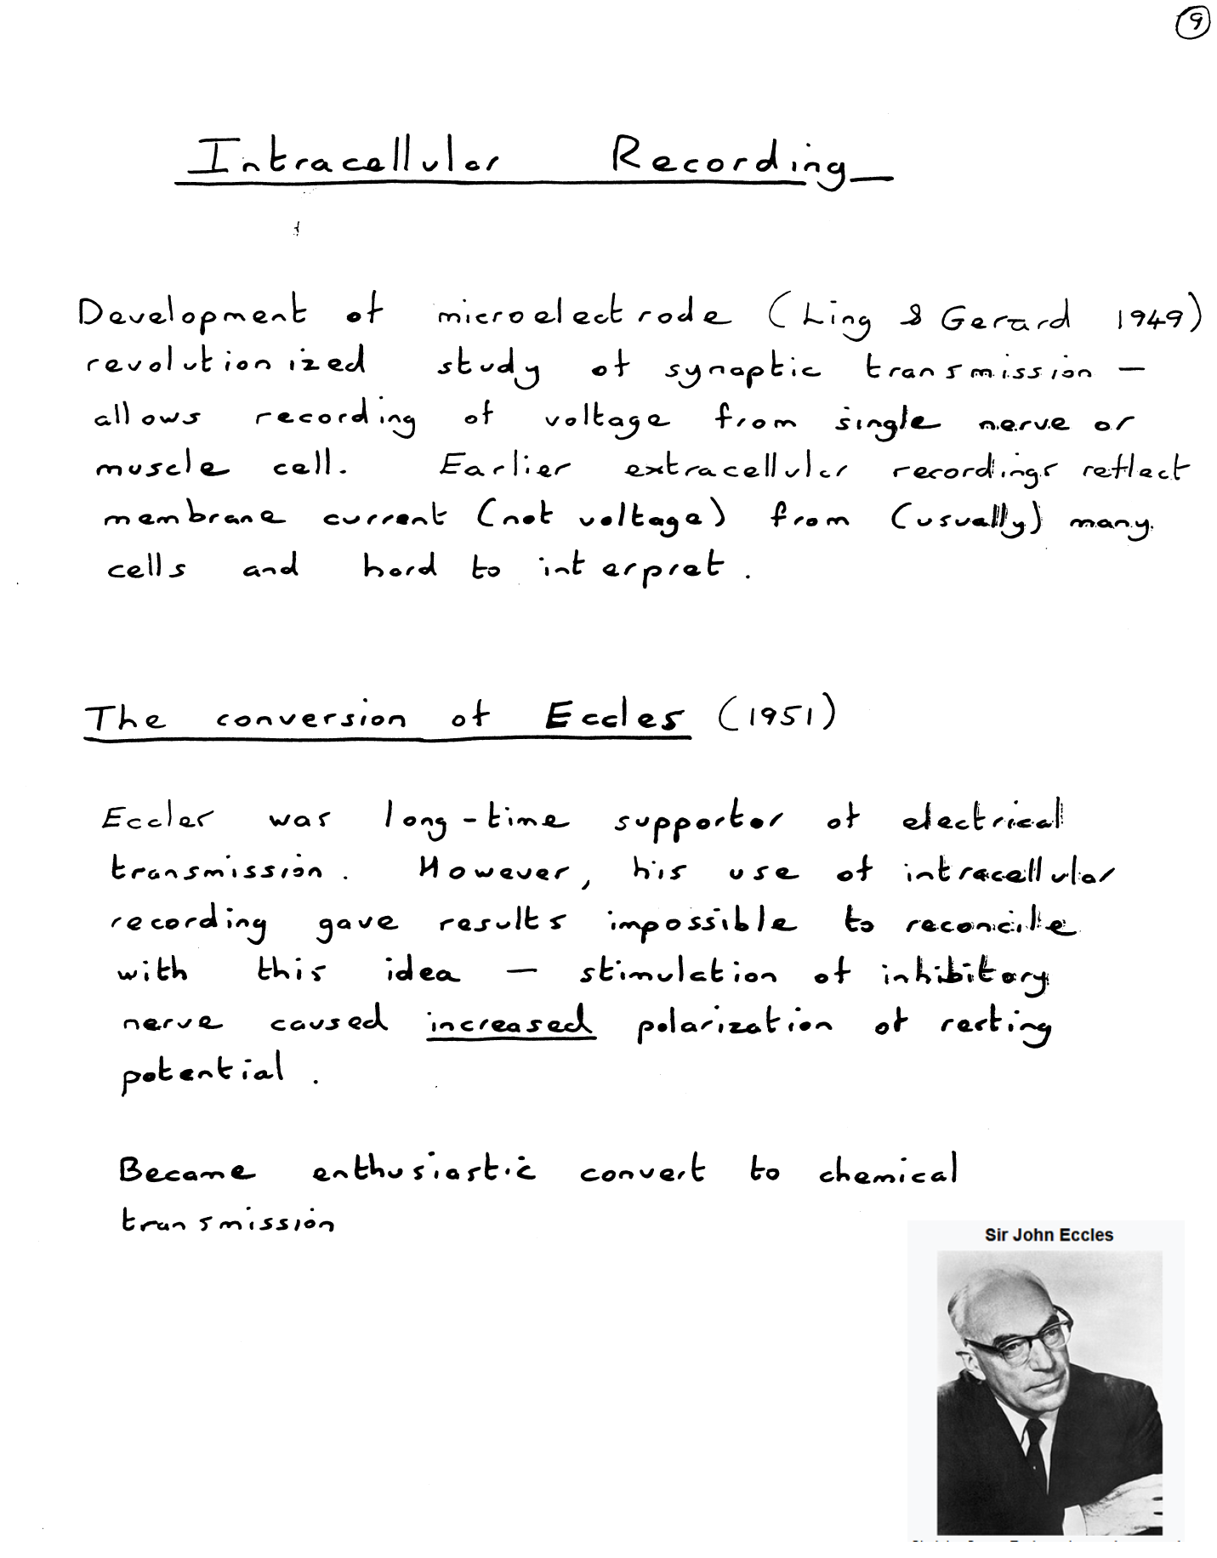

Slide 9
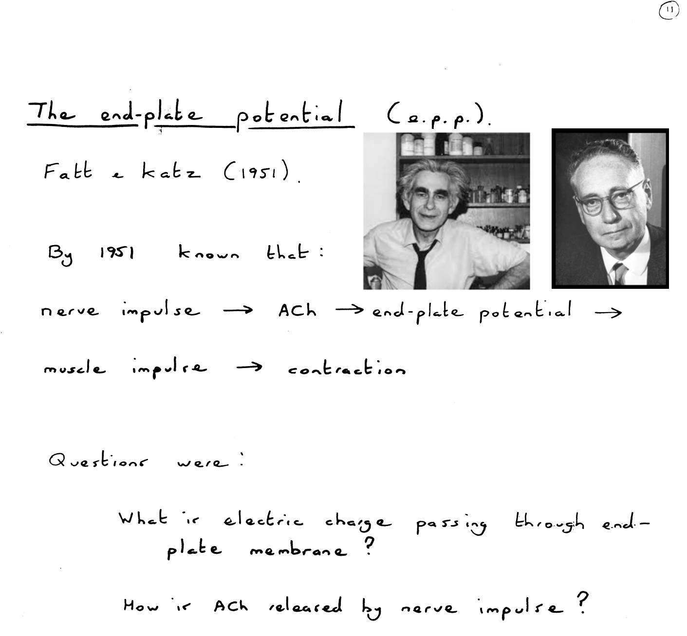

Slide 10
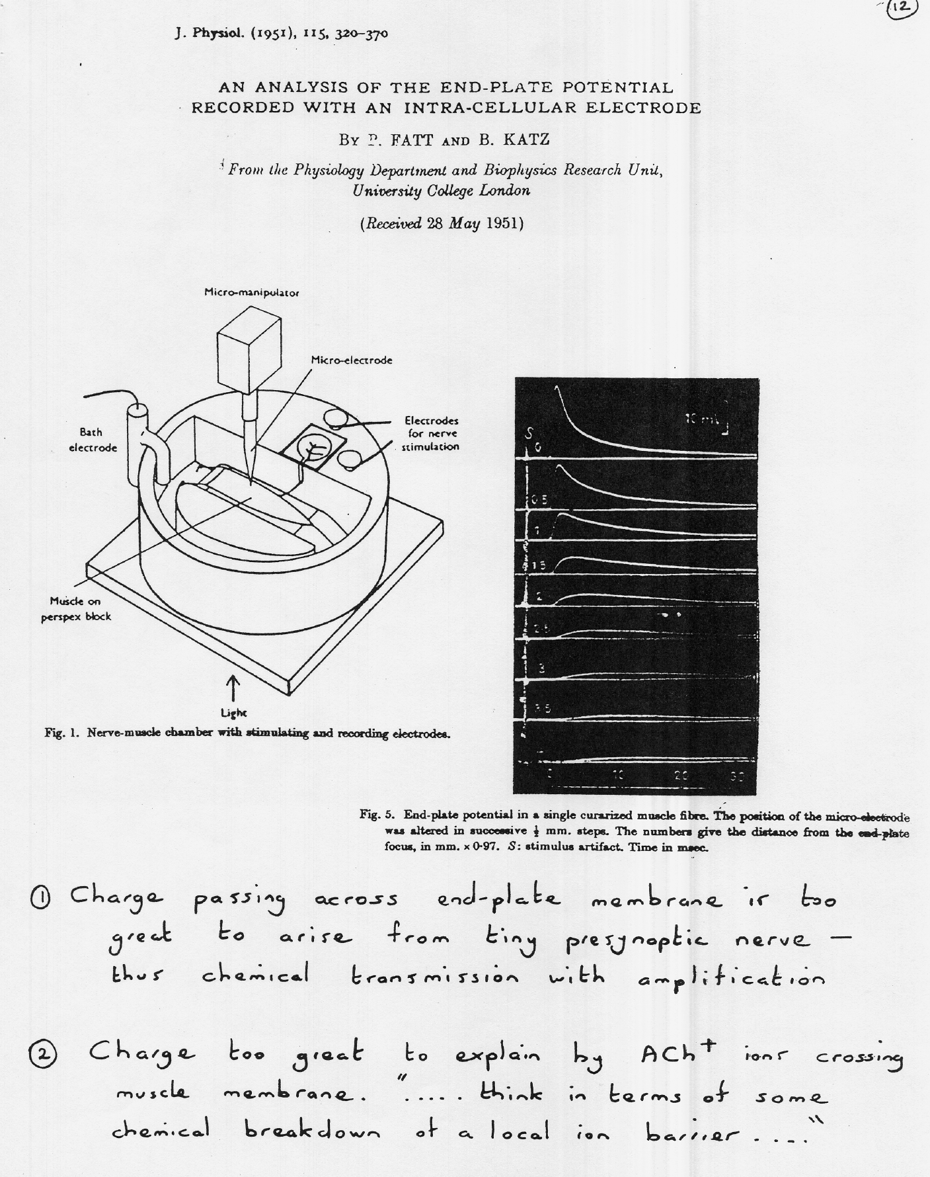

Slide 11
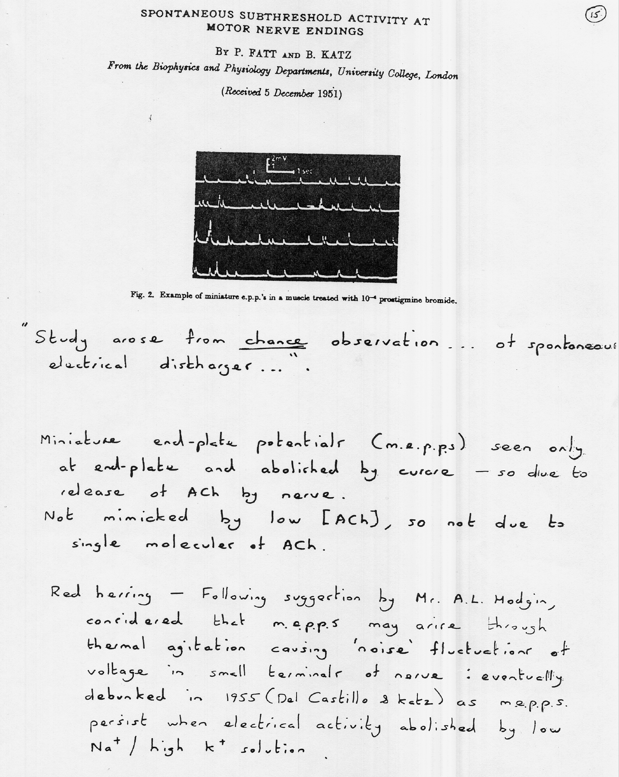

Slide 12
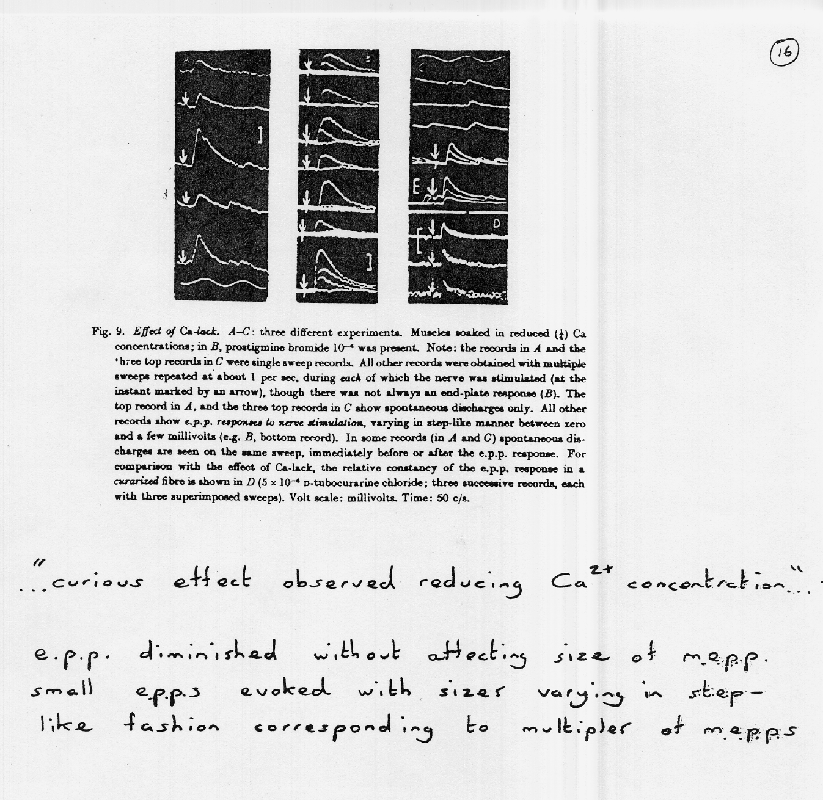

Slide 13
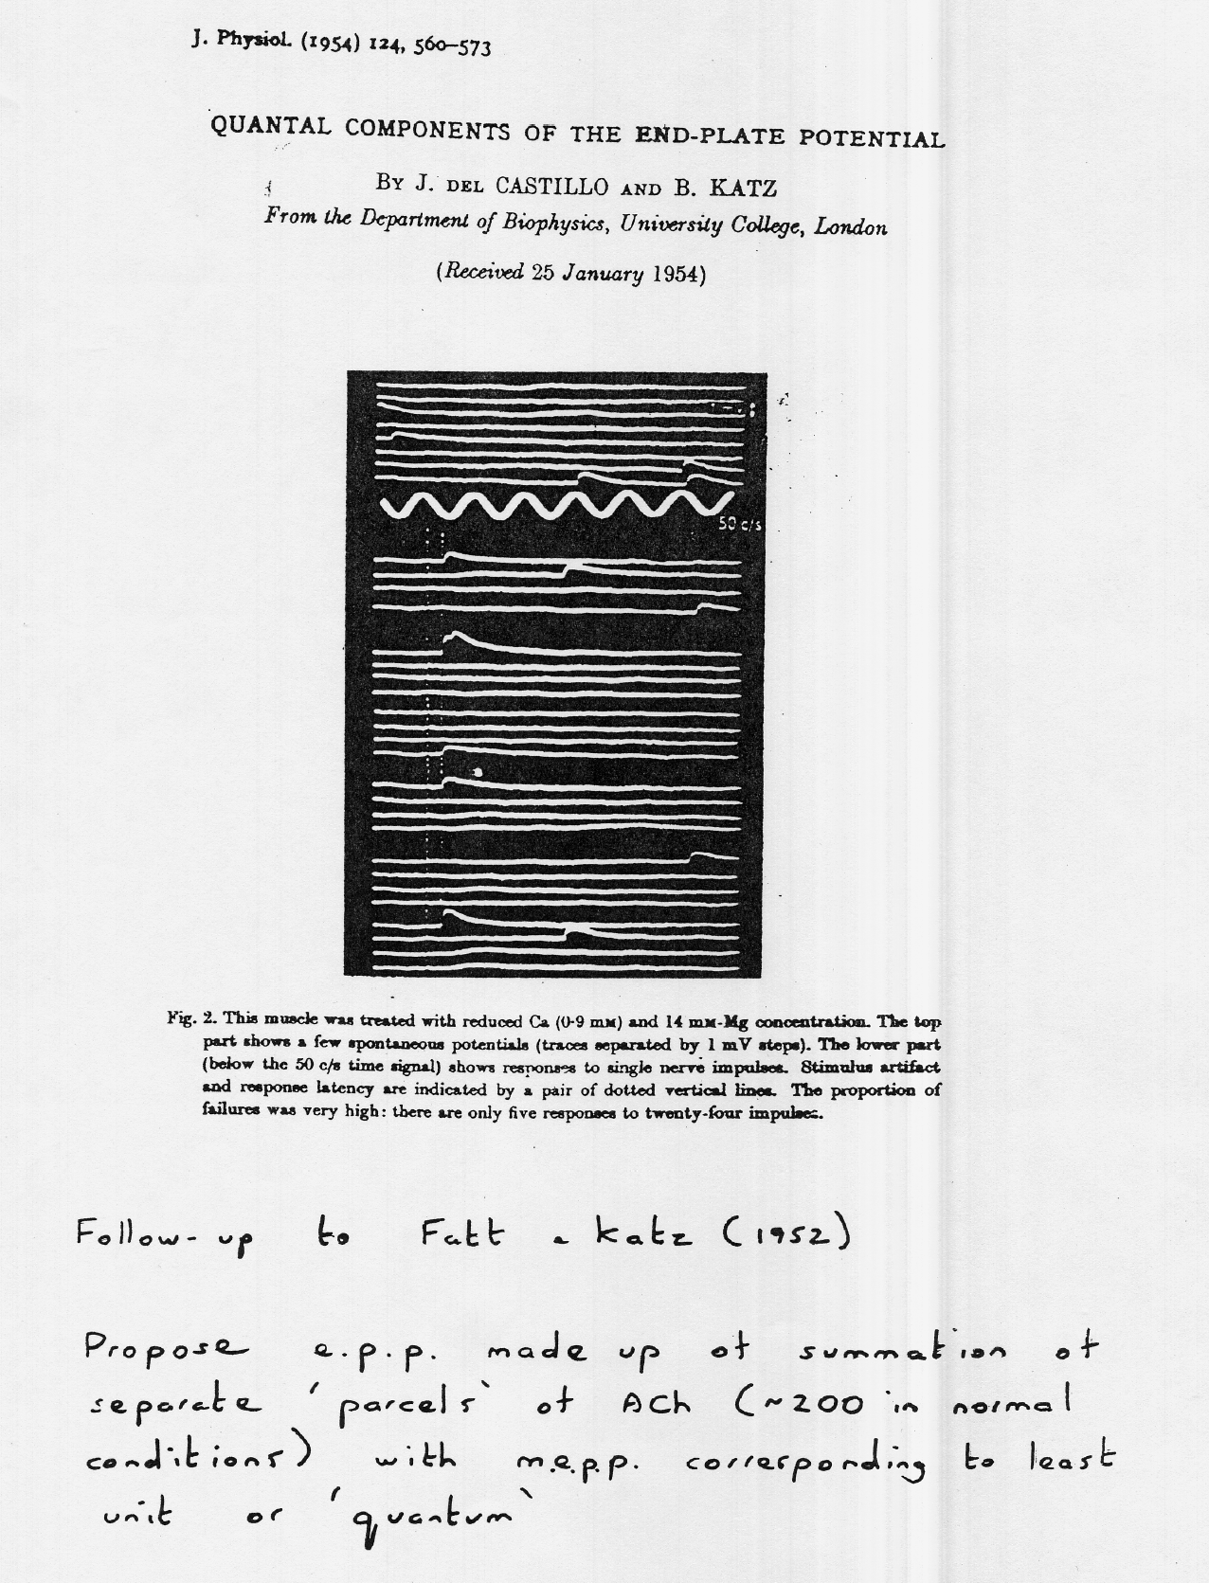

Slide 14
